Slide 1

TERMS OF TRADE
SYLLABUS:
the concept of terms of trade and the terms of trade index

Slide 2
WHAT IS THE TOT?
The terms of trade (TOT) is an index which measures the relative movements in the prices of exports (X) and imports (M)
The ratio of export prices to import prices
The TOT provides a measure of the quantity of imports a country can obtain in exchange for a given volume of exports.
Why is the TOT important?
Changes in the import price index (MPI) and the export price index (XPI) will affect the value of our total X and M →impact on the current account, the exchange rate and national income.
Notes:
If tot increases = x prices rise > m prices = value of x> value of M → improve tradebalance/BOGS -> CAB

Slide 3
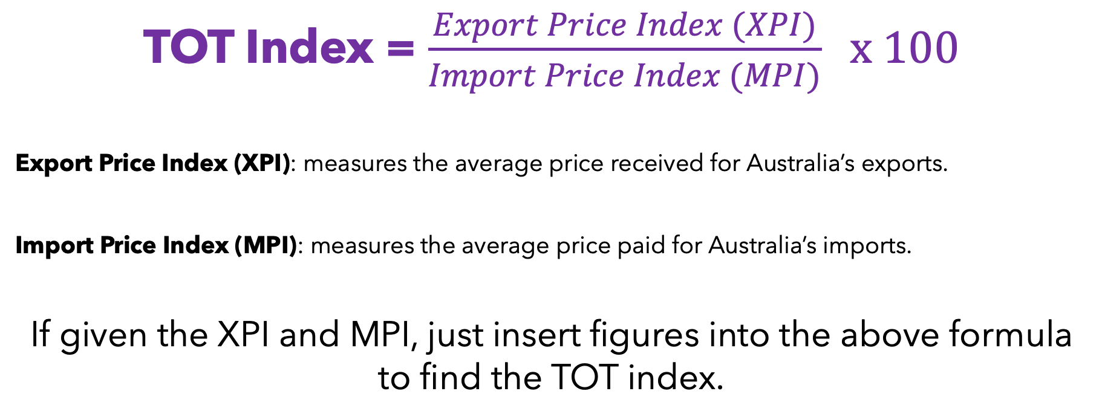
CALCULATING THE TOT INDEX
TOT Index = $\frac{Export Price Index (XPI)}{Import Price Index (MPI)} x 100$
Export Price Index (XPI): measures the average price received for Australia’s exports.
Import Price Index (MPI): measures the average price paid for Australia’s imports.
If given the XPI and MPI, just insert figures into the above formula to find the TOT index.

Slide 4
EXAMPLE - XPI
Imagine Australia exports mostly iron ore, coal, and LNG.
China’s construction sector is booming and needs a lot of steel and so demand for Australian iron ore rises sharply!
Demand-pull inflation leads to the world price of iron ore jumping from $100 per tonne to $150 per tone
At the same time; LNG prices stay about the same & Coal prices rise slightly due to a colder winter in Asia.
When the ABS calculates the Export Price Index, it looks at the weighted average price change across all our main exports. Iron ore has a big weight in the index, so that large price increase pushes the whole XPI up — even if some other export prices barely change.
This increase in the XPI means that, on average, Australia is receiving more money per unit of exports than before.
If import prices stay the same, this will cause the terms of trade to improve — meaning Australia can now buy more imports for the same amount of exports.

Slide 5
EXAMPLE - MPI
Australia imports a lot of petroleum, motor vehicles, and computers.
Suppose the political instability in the Middle East that disrupts global oil supply. This causes the world price of crude oil to jump from $80 a barrel to $120 a barrel.
Since Australia imports most of its fuel, the cost of refined petrol, diesel, and other petroleum products rises sharply.
At the same time; the price of imported motor vehicles stays steady and the price of imported electronics falls slightly due to new manufacturing technology.
When the ABS calculates the Import Price Index, the large increase in oil prices (which has a big weight in the index) outweighs smaller changes in other goods. As a result, the MPI rises.
If export prices don’t rise by as much, the terms of trade will fall — meaning Australia now has to export more goods to buy the same quantity of imports.

Slide 6
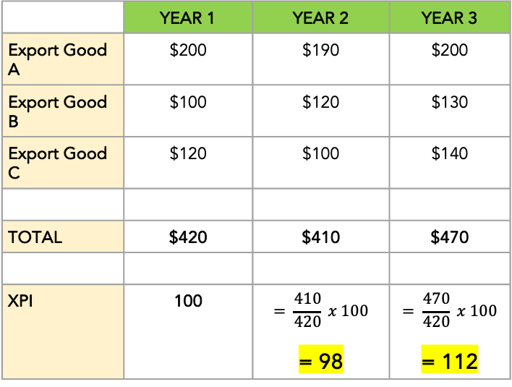

CALCULATING AN XPI/MPI
If you are not given the XPI/MPI, you will need to find the figure from given data by using the following steps.
Add the totals of prices for each year
Assign a base year and give it an index of 100
This means that the value of the base year = 100%
$XPI= \frac{Total price of each year}{Total price of the base year }$ x 100
The MPI would be calculated the same way.
 | YEAR 1 | YEAR 2 | YEAR 3
Export Good A | $200 | $190 | $200
Export Good B | $100 | $120 | $130
Export Good C | $120 | $100 | $140
TOTAL | $420 | $410 | $470
XPI | 100 | $$= \frac{410}{420} x 100$$ = 98 | $$= \frac{470}{420} x 100$$ = 112
BASE YEAR - Assigned an index of 100
What does the XPI mean?
If you calculate the rate of change then you can find the % increase or decrease.
From year 1 to year 2 = 98 - 100 = fall of 2%,
From year 2 to year 3 = 112-98 = 14% rise

Slide 7
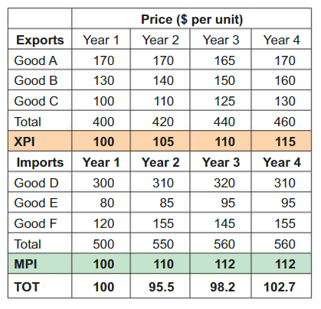
HAVE A GO!
Find the missing XPI and MPI figures
Calculate the TOT for years 2-4
Calculate the percentage change in the TOT for Y2, Y3 and Y4.
Give potential reasons for the change in the TOT for each period.
Notes:
Y2 95.5 – TOT fell by 4.5%
Reason – Rise in M prices greater than the rise in X prices.
Y3 – 98.2 TOT rose by 2.83%
Reason – Rise in X prices greater than the rise in M prices.
Y4 – 102.7 TOT rose by 4.58%
Reason – No change in M prices, however X prices continued to rise.

Slide 8
SOLUTIONS
Y2 – TOT fell by 4.5%
Reason – Rise in M prices greater than the rise in X prices.
Y3 – TOT rose by 2.83%
Reason – Rise in X prices greater than the rise in M prices.
Y4 – TOT rose by 4.58%
Reason – No change in M prices, however X prices continued to rise.

Slide 9
UNDERSTANDING A RISE OR FALL IN THE TOT
The absolute value of the TOT is NOT as important as the CHANGE from year to year.
For example, if the TOT for year 3 was 109.5, that number is not important, what is important is whether it has risen or fallen from the previous year.
We talk about the TOT being favourable or unfavourable from year to year.
A rise in the TOT is seen as favourable.
A fall would be unfavourable.
Year 1 | 100
Year 2 | 95.5
Year 3 | 97.4
Year 4 | 101.9
TOT has fallen by 4.5% = UNFAVOURABLE
TOT has risen 1.9% = FAVOURABLE
TOT has risen 4.6% = FAVOURABLE

Slide 10
RISE IN THE TOT (FAVOURABLE)
Means that export prices rise relative to import prices
Caused by XPI rises and/or MPI falls
OR Could get XPI and MPI rising but for TOT to rise, XPI must have risen by more
OR Could be Fall in XPI and MPI, but for TOT to rise MPI must fall by more
Means that we can purchase more imports with a given quantity of exports
In other words, purchasing power has increased

Slide 11
FALL IN THE TOT (UNFAVOURABLE)
Means that import prices rise relative to export prices
Caused by XPI falls and/or MPI rises
OR Could get a fall in XPI and MPI, but for TOT to fall XPI must fall more
OR Rise in XPI and MPI, but for TOT to fall MPI must rise by more
Means we can purchase less imports with a given quantity of exports
In other words, purchasing power has declined

Slide 12
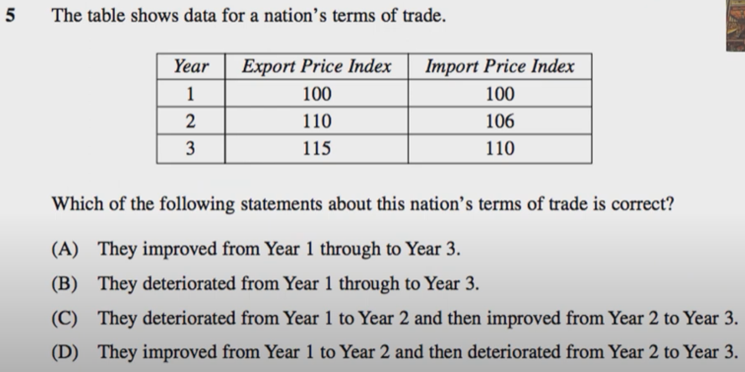
PAST EXAM QUESTIONS
Notes:
Y1= 100
Y2= 110/106*100 = 104
Y3= 115/110 *100 = 105

Slide 13
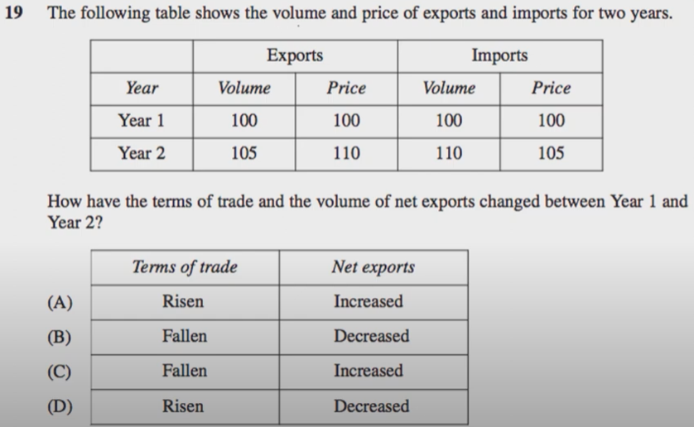
PAST EXAM QUESTIONS
Notes:
TOT focus on price not volume = ignore volume
Y1= 100
Y2= 110/105 *100 = 105
Step 2 then look at volume to see if TB increase or decreasse

Slide 14

In your notebook,
Complete review questions on TB page 88, mcq 1-8 on p97

Slide 15
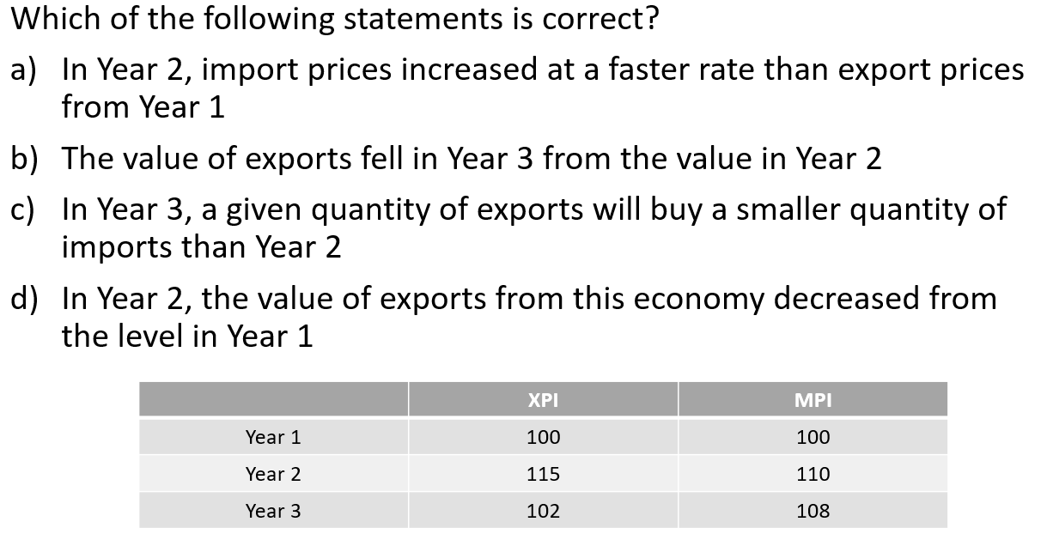

Slide 16
Year 1: 100/100 ×100 = 100
Year 2: 115/110 ×100 = 104.5 (ToT improves)
Year 3: 102/108 ×100 = 94.4 (ToT deteriorates)
So, in Year 3 a given quantity of exports buys fewer imports than in Year 2 → statement (c) is correct.
Why the others are wrong:
(a) Import prices rose 10% (110→ from 100), export prices rose 15% (115 from 100) → imports did not increase faster.
(b) & (d) talk about the value of exports (price × quantity). We only have price indexes, no quantities, so we can’t conclude value fell/declined.

Slide 17
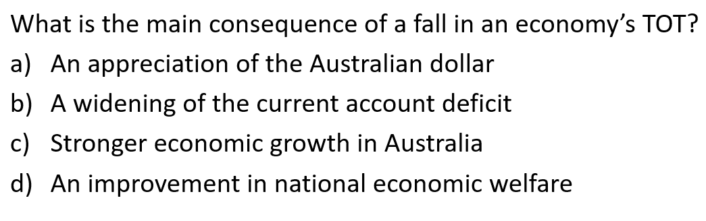

Slide 18
A) Appreciation of the AUD → More likely to cause a fall in TOT if driven by weaker export prices, but it’s not the main consequence.
C) Stronger economic growth in Aus → Not a direct result; in fact, a fall in TOT generally reduces growth prospects.
D) Improvement in national economic welfare → The opposite usually happens; falling TOT means reduced real purchasing power from trade.

Slide 19
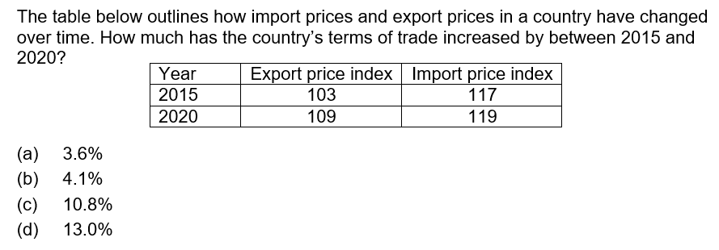

Slide 20
Step 1: Calculate ToT for both years
2015:
(103/117) x 100 = 88
2020:
(109/119) x 100 = 91.6
Step 2: Calculate the percentage increase in ToT
(91.6-88)/88 x 100 = approx. 4.1%

Slide 21
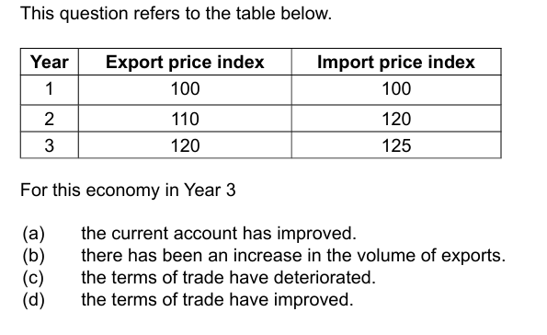

Slide 22
Step 1: Calculate ToT for year 2 & 3
Year 2 = 91.67
Year 3 = 96
Step 2: What happened in year 3?
Step 3: Eliminate answers
Notes:
(a) "The current account has improved." → We don't have data about export/import volumes or income/transfers, so we can't say this.
(b) "There has been an increase in the volume of exports." → Export price rose, but nothing is said about volume.
(c) "The terms of trade have deteriorated." → No—they improved from 91.67 to 96.
(d) "The terms of trade have improved." → Correct. Export prices rose more (proportionally) than import prices from Year 2 to 3.

Slide 23
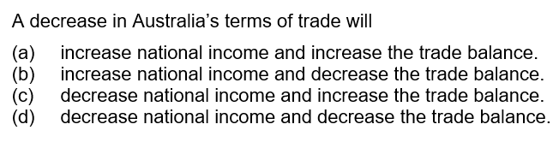

Slide 24
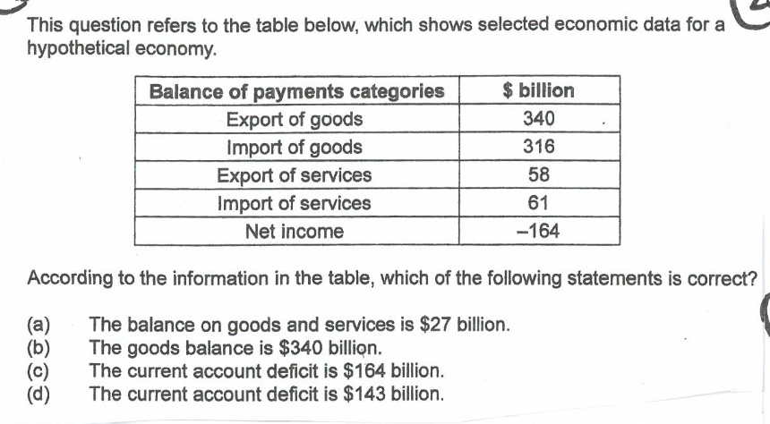

Slide 25
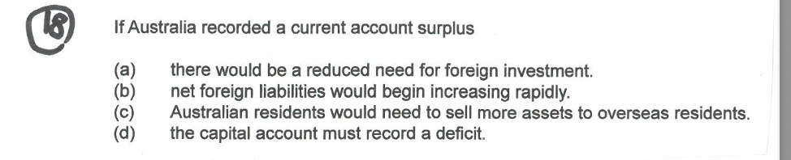

Slide 26
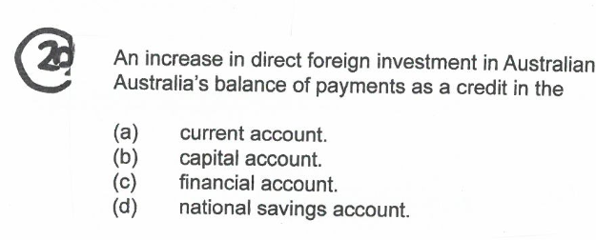

Slide 27
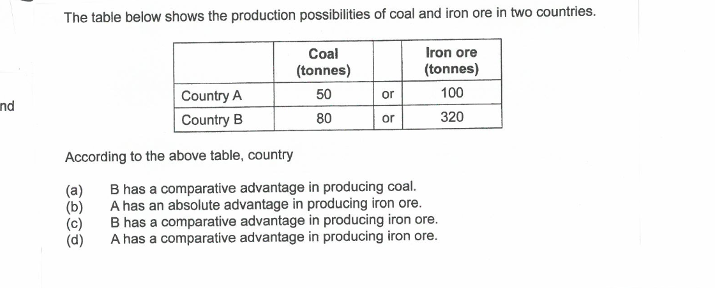

Slide 28


FACTORS THAT AFFECT THE TOT
SYLLABUS:
Factors that affect terms of trade including changes in commodity prices

Slide 29
FACTORS AFFECTING THE TOT
Australia is generally a 'price taker’ for both X & M as we are a medium-sized economy
This means that X and M prices are determined on global markets (not us).
The main factors that affect the TOT are:
Commodity prices
Manufactured goods prices
Oil prices

Slide 30
COMMODITY PRICES
Commodities tend to be inelastic in BOTH demand and in supply and therefore have a relatively steep D&S curves - so small shifts in D and S can lead to large fluctuations in price (big effect on export revenues and terms of trade).
Inelastic demand | Inelastic supply
Few substitutes globally Commodities are a small proportion of final good and therefore small proportion of final cost Necessity for production – can’t easily stop using them in the short run Global contracts – long term contracts in export markets reduce responsiveness to price changes | Long production lags (mining projects and agricultural cycles take years to adjust output – can’t suddenly produce more because the price went up High capital requirements (investment and time) – difficult to scale instantly Geographical and climate restraints Regulatory & infrastructure limits

Slide 31
COMMODITY PRICES
3/4s (75%) of Australia's exports are commodities (a raw material or primary agricultural product that can be bought and sold. EG - iron ore, coal, wool, beef, LNG, gold, etc)
Commodity prices are determined on global markets.
If world (or China’s) growth rises --> demand for commodities rises --> rise in the price of commodities --> rise in XPI
If world (or China’s) growth falls --> demand for commodities falls --> fall in price of commodities --> fall in XPI
If global S rises --> fall in price of commodities --> fall in XPI
If global S falls --> rise in price of commodities --> rise in XPI

Slide 32
Let’s look at fig 4.2 tb pg 90
Iron Ore market
Suppose the Chinese economy expands, shifting the world demand for iron ore to the right (D2). This causes the price to increase from P1 to P2 and the quantity sold increase from Q1 to Q2.
Australia’s iron ore exporters will be extremely happy (sell more at a higher price)
Aus XPI will increase
CAB increase (ceteris paribus)
National Income increases
S
P2
P1
D1
D2
Q1
Q2

Slide 33
COMMODITY PRICES
In summary, as the Chinese/global economy expands, the demand for global resources also expands. Thus, global commodity prices rise and Australia's XPI rises --> favourable change in the TOT
However, if global/Chinese growth contracts then global demand for resources falls --> fall in commodity prices --> fall in Australia's XPI --> unfavourable change in the TOT
A decrease in demand and/or increase in supply will lead to a fall in commodity prices, vice versa.

Slide 34
MANUFACTURED GOOD PRICES
The supply of Manufactured goods tend to be elastic in nature with a relatively flat supply curve, so changes in demand has little effect on price.
Elastic demand | Elastic supply

Slide 35
MANUFACTURED GOOD PRICES
Most of Australia's imports are manufactured and intermediate goods (household appliances, equipment, machinery and ICT)
As China has grown into the world’s largest manufacturer, the price of manufactured goods has declined. This has been assisted by increases in productivity from technology, labour training etc.
Prices of ICT goods also tend to fall over time due to advancements in technology which lowers costs of production.
Thus, if the import price of manufactured and intermediate goods falls --> fall in MPI --> rise in TOT and vice versa
During Covid, there were supply bottlenecks → decrease in supply → increase M prices → rise MPI → fall in TOT

Slide 36
OIL PRICES
The global oil price is volatile (inelastic good) and Australia is a significant importer of oil
Global oil price is decided on global markets via forces of demand and supply
For e.g. 2022-2024, Ukraine-Russia War and tensions in Middle East spiked oil prices. → rise in MPI → deterioration in TOT
Higher oil prices potentially affect all import prices because it increases energy and transport costs.

Slide 37
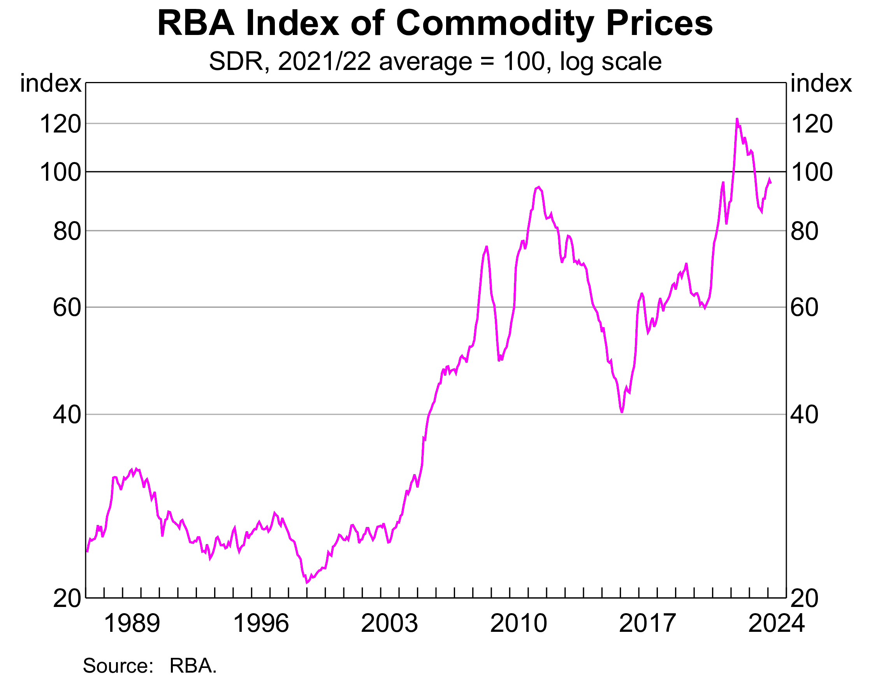
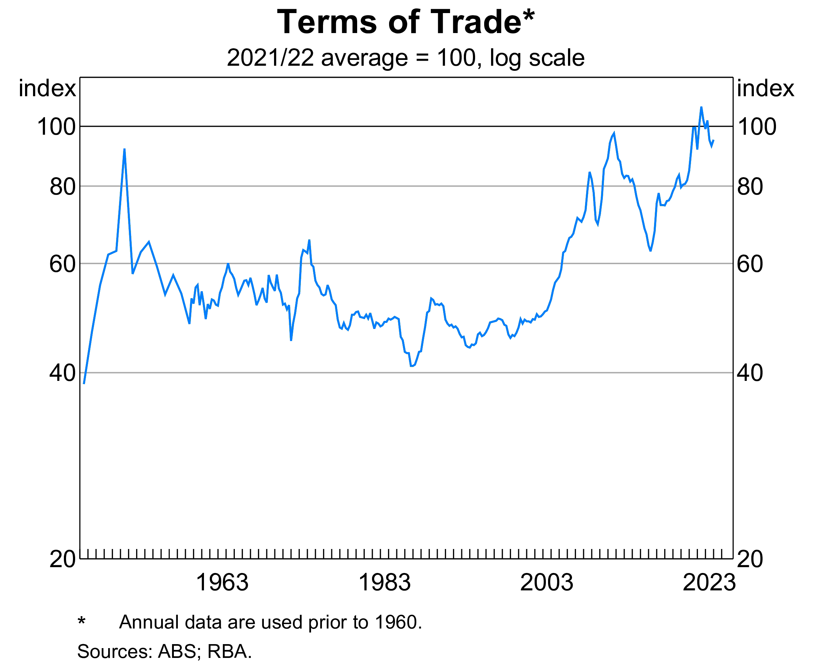
COMMODITY PRICES VS TOT
Can you see a similar trend between commodity price and the TOT?
Due to commodities being Australia’s largest export, and the fact that commodity prices are volatile, commodities tend to be the biggest driver of changes in the TOT

Slide 38
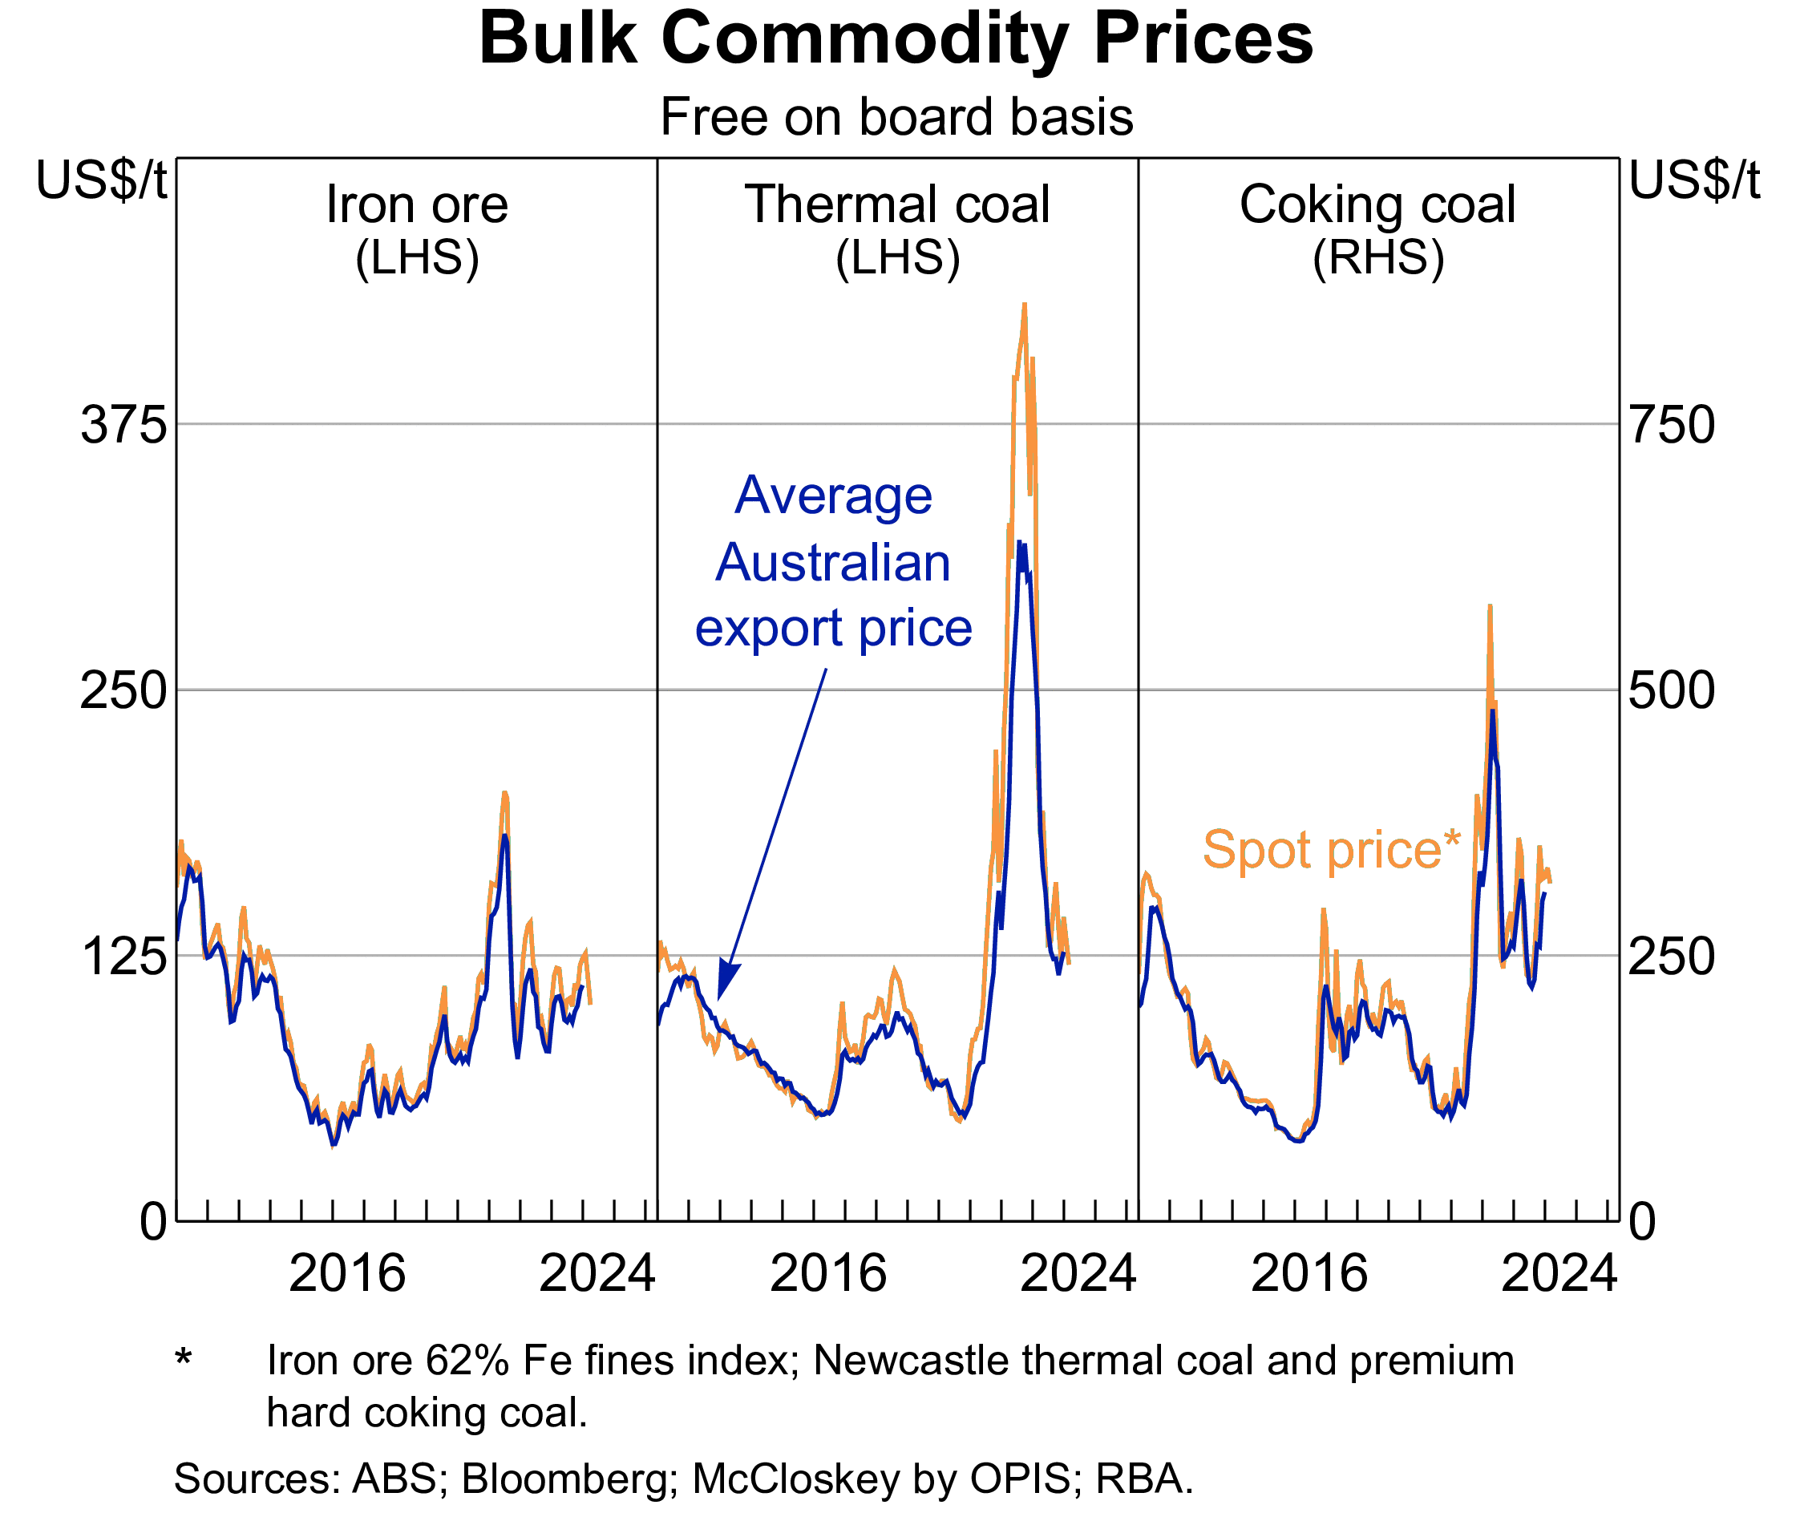
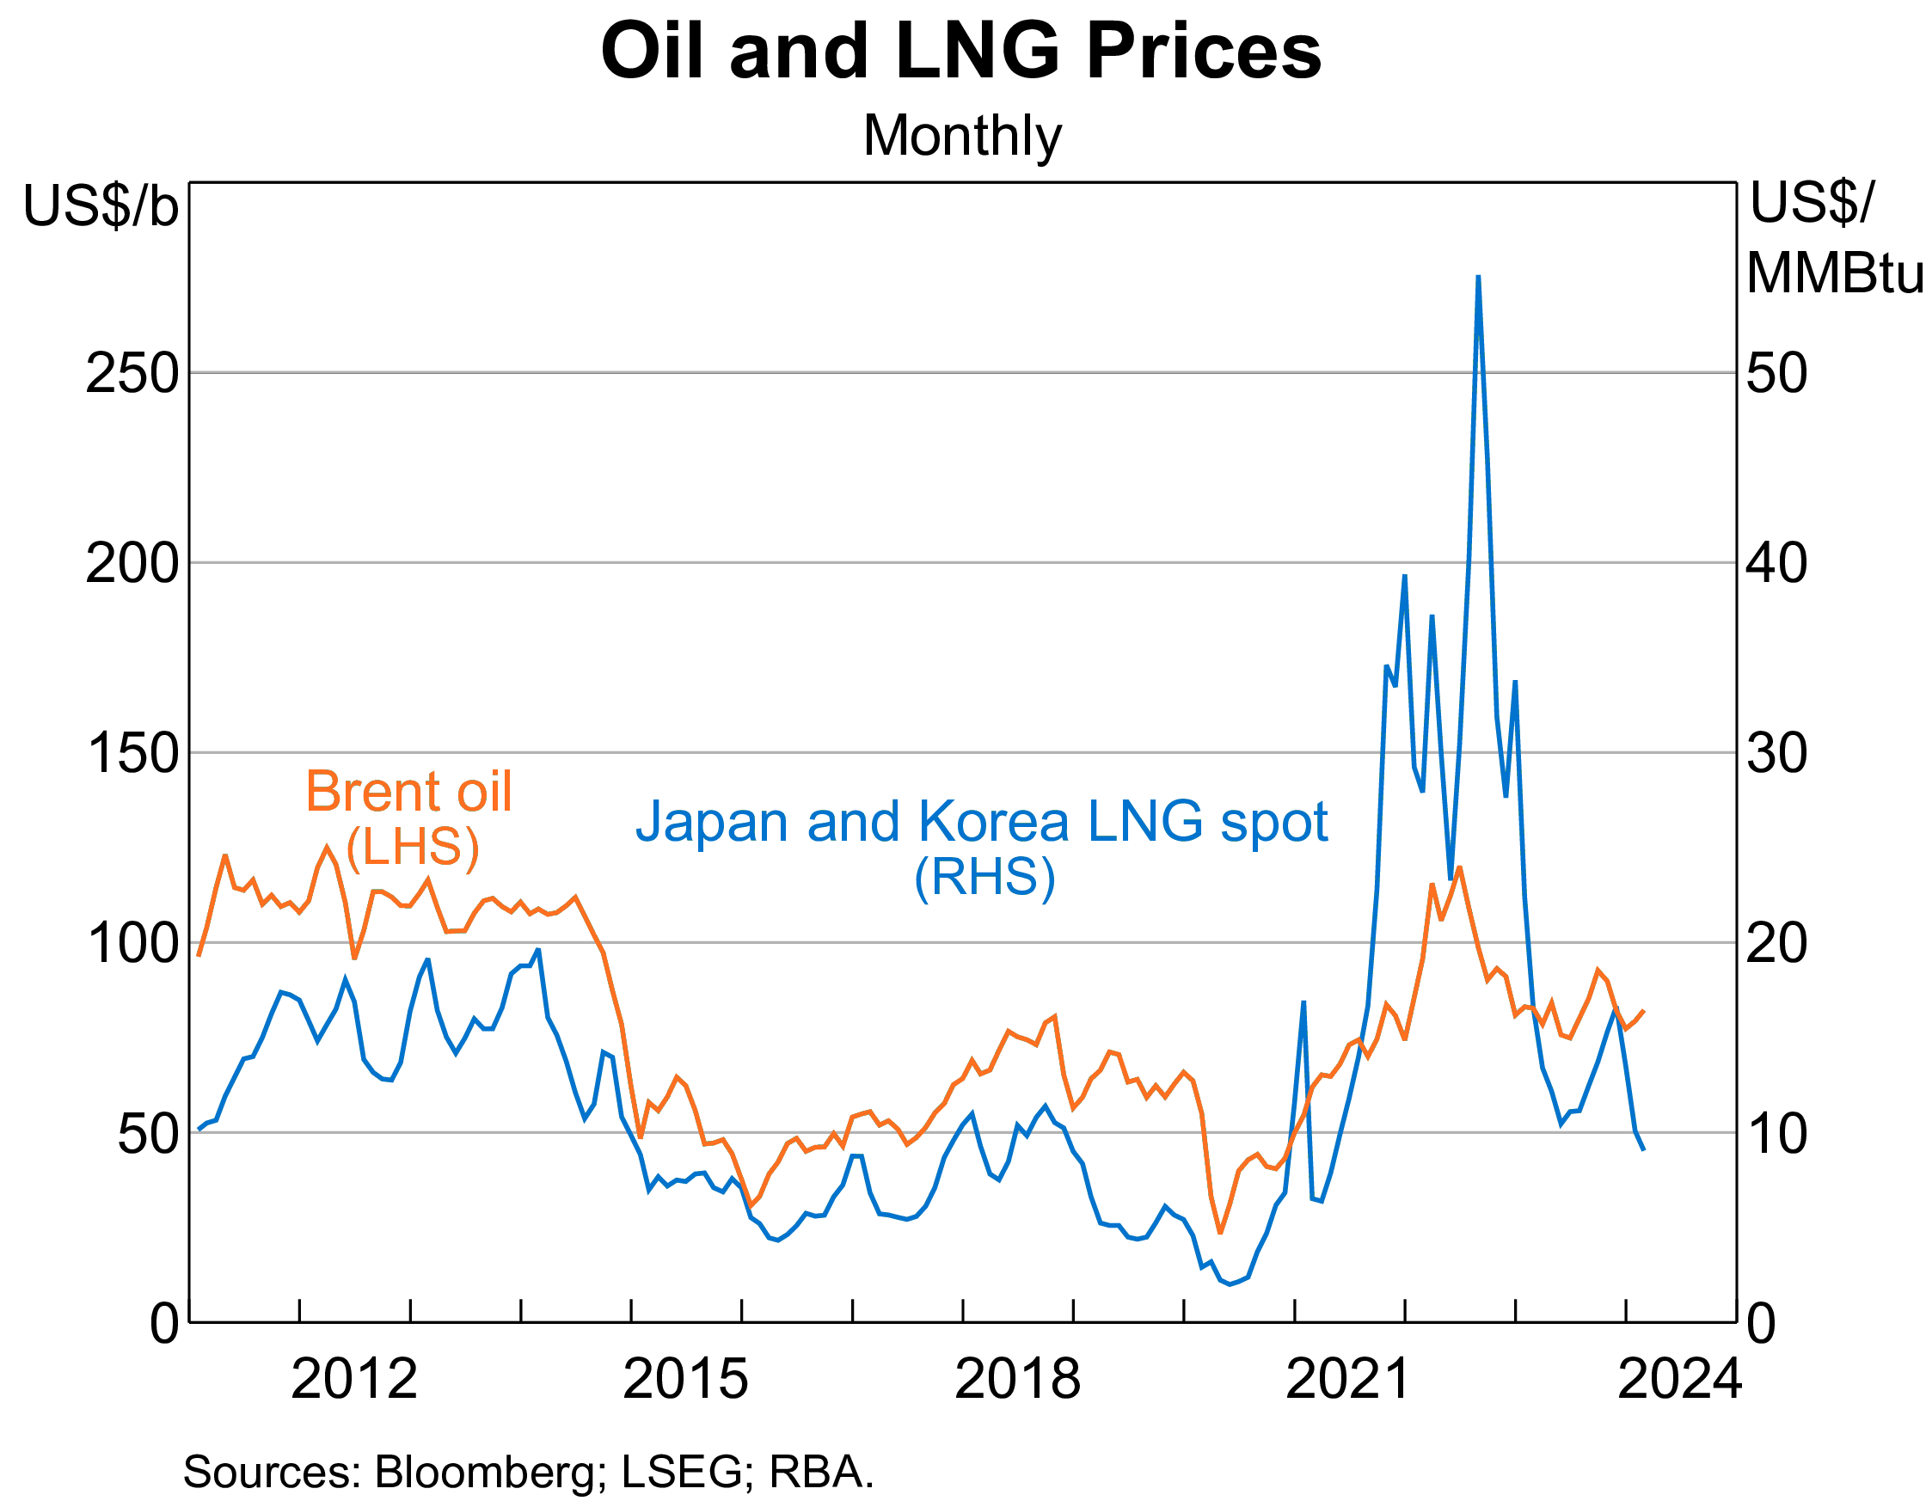

Slide 39
Use TOT key points to complete extended response 1b p100
 | Increase in TOT | Decrease in TOT
Meaning | XPI rises relative to MPI (More imports can be purchased from a given volume of exports) | MPI rises relative to XPI (Fewer imports can be purchased from a given volume of exports)
Causes | Increase in commodity prices Natural disasters increasing rural prices Fall in global oil prices Fall in manufacturing costs Technology lowers ICT prices | Decrease in commodity prices Increase in global oil prices Increase in supply bottlenecks Increase in manufacturing costs
Effects | Increase in Trade balance / BOGS (X-M) Increase in real GDP & National income Unemployment rate decreases Increase in government tax revenue Rise in living standards Investment and Employment rises in resources sector AUD appreciates (More demand for our currency) Inflation rate increases | Decrease in Trade balance / BOGS (X-M) Decrease in real GDP & National income Unemployment rate increases Decrease in government tax revenue Fall in living standards Investment and Employment falls in resources sector AUD depreciates (Less demand for our currency) Inflation rate decreases

Slide 40
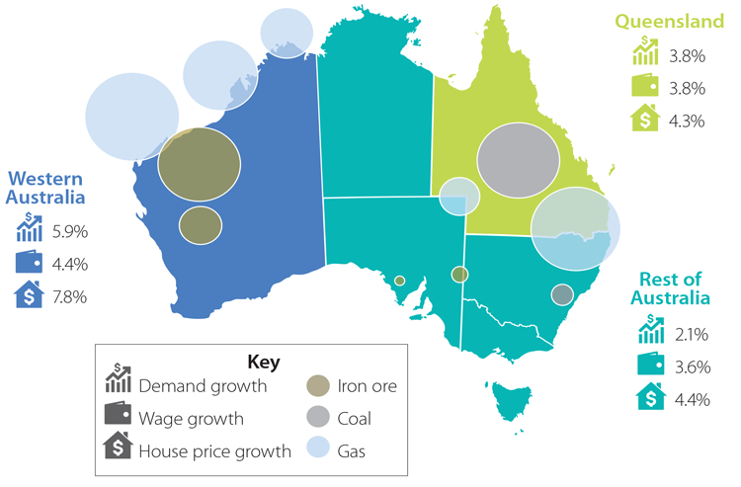
TRENDS IN TERMS OF TRADE
SYLLABUS:
trends in Australia’s terms of trade over the last 10 years

Slide 41
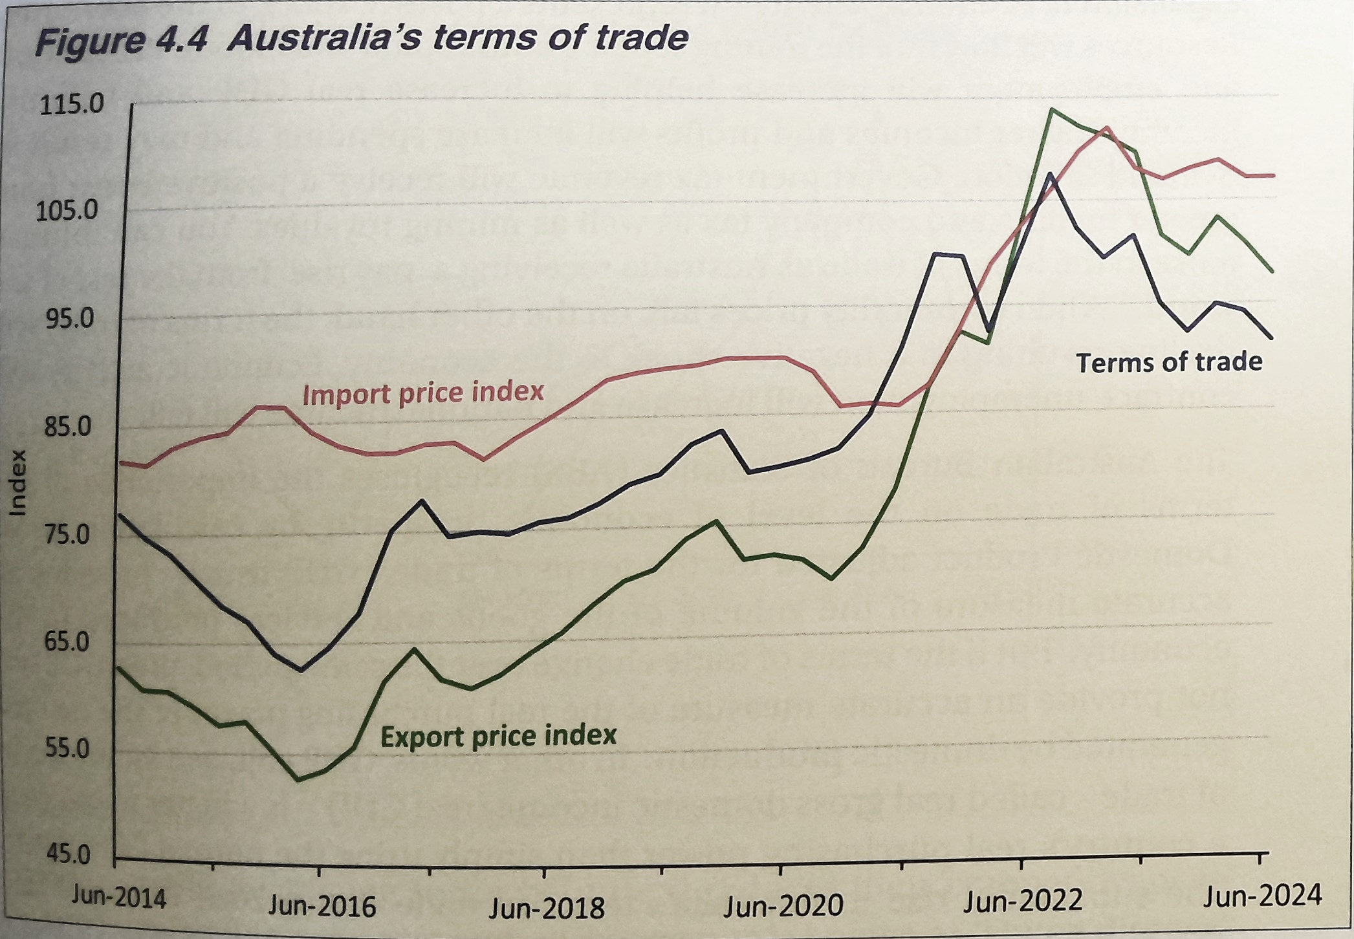
You need to know the past ten years but really concentrate on post 2020 to explain very well
Overall rise in TOT from 2016 to 2022.

Slide 42
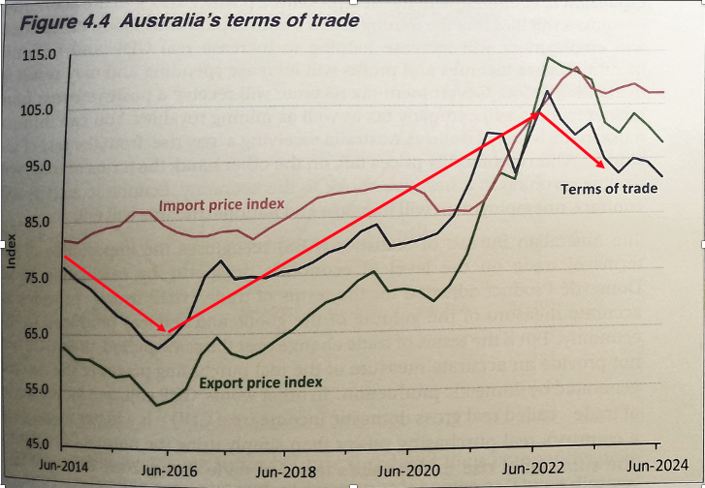
TOT is more closely correlated with the XPI than the MPI
MPI is relatively less volatile than XPI
Fluctuates from a low of 83 to a high of 113 (range 29)
In comparison, XPI low of 64 to a high of 114 (range (60)
Can you think of WHY??
Supply of manufactured goods is more elastic than the supply of primary commodities

Slide 43
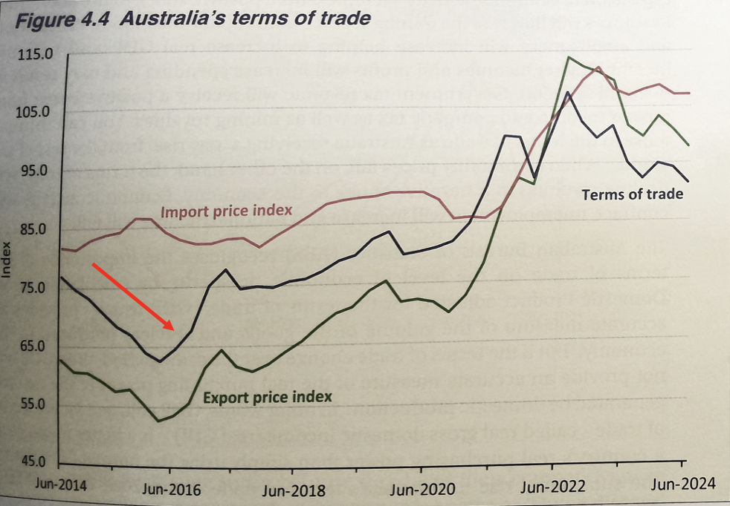
2014-15: TOT FALLING
XPI falling
World Commodity prices start to fall
Increased S on global commodity markets and falling global D as growth slows in China ➝ decreased price of commodities
Iron Ore $180 per tonne to $40 a tonne (2011 to 2015)
Fall in Global Oil prices
Last quarter of 2015 oil prices dropped from $US 48 to $US 32 (33% fall) - due to weak demand and end of trade sanctions against Iran leading to rising supply
Led to a fall in the price of Australia’s energy substitutes such as coal and natural gas
MPI stable
Lack of growth in import prices over this period

Slide 44
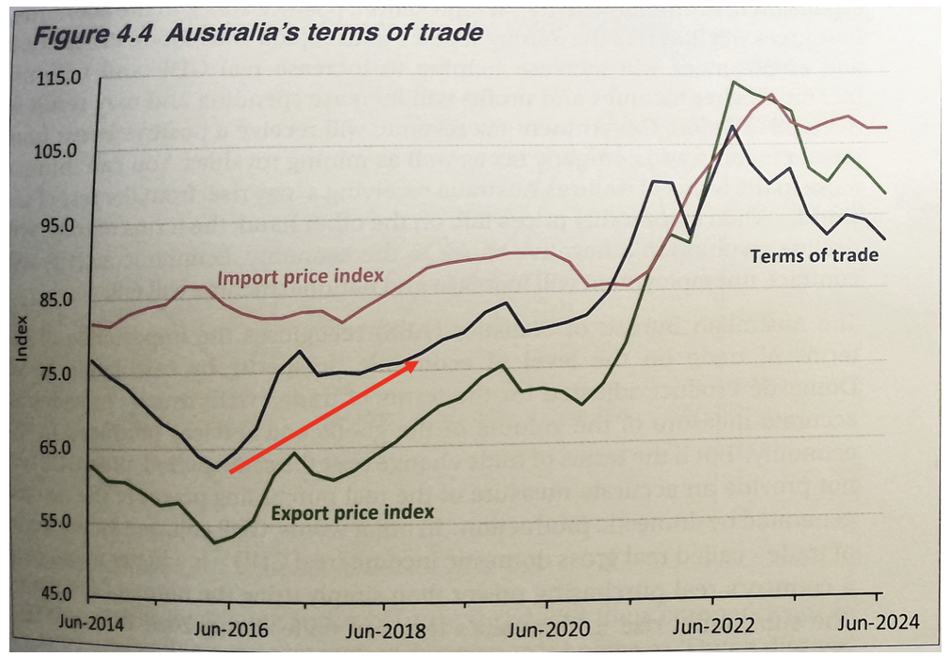
2016-19: TOT RISING
XPI rising (40%)
World economic growth increase → Rise in Commodity prices
Particularly coal and iron ore due to strong growth in China
Rise in Oil prices (substitution effect)
Members of the OPEC cartel (which controls global S of oil) stabilised oil prices by stabilising S, thus leading to an increase in global oil prices
Increased demand for oil substitutes ➝ increase XPI (LNG) ➝ increase in TOT (30%)
MPI rising (though by less than XPI)
Rise in Oil prices – one of Australia’s major imports
Somewhat offset by lower manufacturing prices (thus smaller MPI movements)

Slide 45
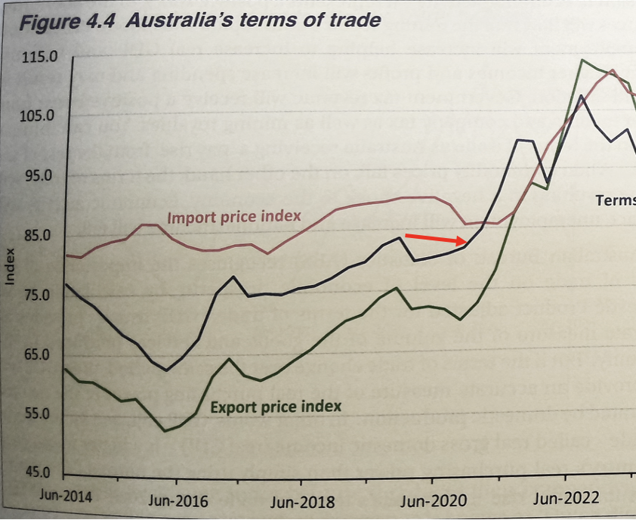
2020 (JUNE & SEPT QUARTER) SMALL FALL IN TOT
XPI Fell
Covid caused a global recession → XPI falling
Fall in LNG and Coal prices due to reduced global energy demand (travel restrictions
MPI Fell
Fall in oil prices due to significant reduction in demand during lockdowns (one of Australia’s major import costs).
Weak global demand for consumption and manufactured goods due to uncertainty/sentiment
Strong AUD in latter half of 2020 → makes imported goods cheaper/more affordable

Slide 46
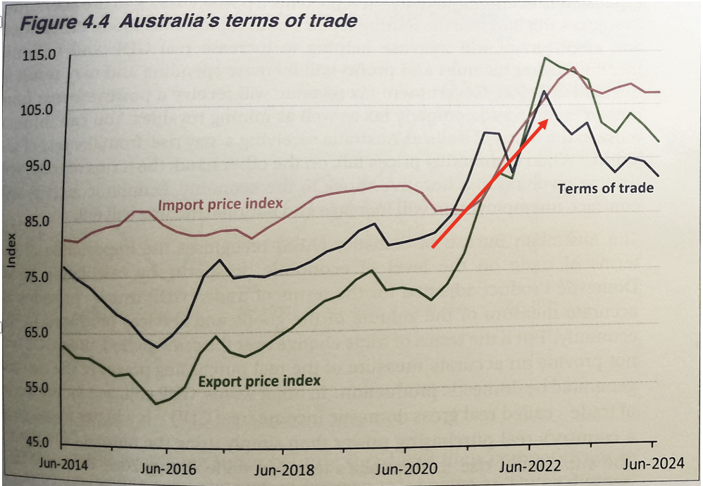
2020-2022 CONTEMPORARY: TOT RISING
XPI rising (after fall in June-Sept qtrs 2020)
Rise in commodity prices (especially coal, gas)
Caused by rising demand for exports. Economies began to recover from 2020 recessions and invest, build, grow ➝ need raw materials ➝ rise in commodity prices
Rise in oil prices (Mar 2022 petrol prices highest in a decade above $2 p/L)
driven by strong global oil demand and constrained global supply (Ukraine- Russia conflict). Increased demand for oil substitutes ➝ incr XPI ➝ incr TOT.

Slide 47
2020-2022 CONTEMPORARY: TOT RISING
MPI rising (after falling through 2020)
While import prices fell through 2020, they began to rise through 2021 due to global supply constraints/shortages forcing prices to rise
Main contributors of these price rises were petroleum, road vehicles and fertilisers

Slide 48
2020-2022 CONTEMPORARY: TOT RISING
Even though both XPI and MPI fell through 2020, the TOT was still favourable (MPI fell more than XPI).
The year to Sept 2021, XPI rose 41%, while MPI rose 6.4% - TOT reached a historic high of 128 index points. However, fell to 125 index points in the Dec 2021 qtr.

Slide 49
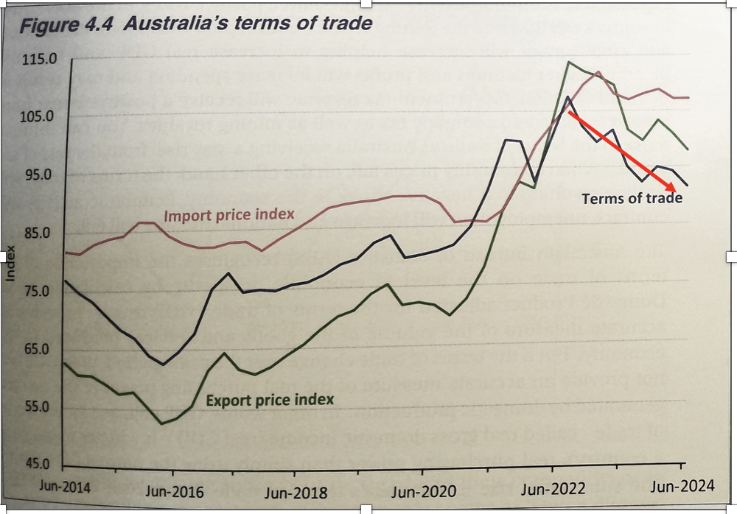
2023- PRESENT CONTEMPORARY: TOT DECLINE
XPI falling
Fall in commodity prices (especially iron ore)
Caused by economic slowdown in China ( less demand for Aus X) → decrease XPI → reduce purchasing power
- Current global economic factors: U.S announced tariffs on Australia steel and aluminium exports (may lead to further downturn and fall in XPI in 2025)

Slide 50
2023- PRESENT CONTEMPORARY: TOT DECLINE
MPI falling
Prices of oil and petroleum fell by 17.7% (mar quarter 2024)
- ← weaker global demand
High inflation in Australia 7% in 2023 → slow down in the economy → decrease in consumption and imports

Slide 51
RESEARCH TASK
Find 1 news article about key factors influencing Australia’s terms of trade
(e.g. iron ore prices, trade relations with China, Oil price changes, tariffs etc)
Create a summary on this article and how the factor has influenced/ will influence Australia’s ToT.
Share with the rest of the class
News articles about key factors influencing Australia’s terms of trade ( 5 years)

